Slide 1
Professional Development for SFSU Cooperating Teachers
Secondary Education
Graduate College of Education
2021

Slide 2
This two-hour Cooperating Teacher (CT) Professional Development (PD) Module counts towards the 10 total hours of PD requirement by the California Commission on Teacher Credentialing (CTC) for CTs.
The other eight hours may include work you have already done, or by participating in other PD opportunities. These eight hours of PD can be documented at the end of this module in a review section.
Welcome, SFSU Cooperating Teachers!
Thank you for agreeing to work with a student teacher (ST). Your role will be to provide guidance and support for the field practice component of their credential program.Your efforts contribute in a critical way to the future of our profession.
We hope you find this training module useful in understanding the Credential Program as well as your crucial role in this process.

Slide 3
Overview
Chapter 2
Cooperating Teacher (CT) Roles, Responsibilities, & Strategies
Chapter 4
Professional Development Resources - Culturally Responsive Teaching (CRT)
Chapter 1
Understanding Program Expectations for Student Teachers (ST)
Chapter 3
Professional Development Resources - Inclusive Education
Chapter 5
Review and Reflections

Slide 4
Chapter 1
Program requirement
Fieldwork details
Teaching performance expectations (TPE)
“EROD”
Understanding Program Expectations for Student Teachers

Slide 5
Program Requirement
Coursework (24 units)
Fieldwork (12 units)
edTPA & Others
8 seminars (completed in 2 or 3 semesters, see sequence): subject area teaching pedagogy, literacy and second language development, adolescent development, building classroom community, professionalism, social justice and equity.
Observation (SED 640) and student teaching (SED 660) at your school and in your classroom
edTPA: a state-approved, performance-based, subject-specific assessment
US Constitution
Educational Technology
CPR (cardiopulmonary resuscitation) certificate

Slide 6
On Distance Learning
We are approaching fall semester 2020 by supporting possibilities for helping students succeed in distance learning environments. We envision classroom-based instructional teams consisting of two student teachers (STs) and one Cooperating Teacher (CT) working to reach students who may otherwise fall away from learning through non-attendance and/or unsuccessful participation in the new remote learning environment. Such students may not be coming to Zoom classes or may have difficulties with internet access or may not have sufficient parental supervision to continue with virtual classes, etc. In other words, the teams would actively address students who are falling through the cracks and not benefitting from this new and unusual while necessary approach to teaching and learning.
Our program seeks to meet schools' individual needs. The CT would have freedom to decide where they need help, and with what groups of students. It will be the CT's decision to match student teachers (STs) with students, to daily meet with the STs to review instruction and address problems in the process, and answer questions the STs might have about students. STs could also co-teach some of the units with the ST. The process would continue in the Spring with the CT assigning the STs with new or revised groups of students.
-- Ms. Guilaine Salomon
Coordinating Supervisor for Field Placements

Slide 7
First-semester Fieldwork for SFSU STs
(Aug-Sep) ST observes as many teachers as possible, regardless of discipline
(Oct-Nov) ST works with CTs and co-teaches by 1) contacting students to increase engagement, 2) providing tutorials via Zoom for selected students, 3) following-up with absent students and work to identify and resolve distance learning problems such as lack of technology or training, 4) working with parents or others at home to improve overall student supervision and support, and 5) working with site staff to address issues that were evident in implementing distance learning.
(entire semester) ST gets to know the school, teachers, and students
(Sep-Oct) ST identify CT(s) and their classes; get district email to access Zoom, Google Classroom
ST plans/teaches a 3-day sequence before Thanksgiving and receives feedback and evaluations from CT and a University Supervisor;
Student-teaching begins in early January.

Slide 8
Second-semester Fieldwork for SFSU Student Teachers
plans/teachs 2 classes the entire semester (face-to-face); continues co-teaching one class or teaching solo with CT supervision (distance learning).
receives 2 formal feedback and evaluations (EROD) from the CT and the University Supervisor, respectively.
completes edTPA in one of their student teaching classes
shadows CTs for 2 consecutive weeks.

Slide 9
Teaching Performances Expectations (TPEs)
TPE 1
TPE 2
TPE 3
TPE 4
TPE 5
TPE 6
Engaging & Supporting All Students in Learning
Creating and Maintaining Effective Environments for Student Learning
Understanding & Organizing Subject Matter for Student Learning
Planning Instruction & Designing Learning Experiences for All Students
Assessing Student Learning
Developing as a Professional Educator

Slide 10
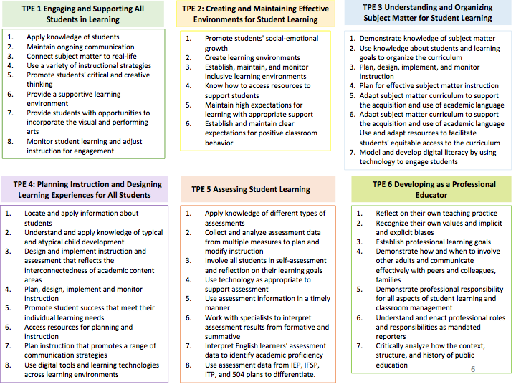
Design: Diane Garfield, Elementary Education, SFSU

Slide 11
Evaluation Report For Observations And Documents (EROD)
The CT and the University Supervisor form a team to support the ST especially in a distance learning co-teaching model.
The CT and the University Supervisor also observe and assess the ST’s teaching effectiveness based on 6 TPEs as delineated in the Evaluation Report for Observations and Documents (EROD).
Please contact the University Supervisor of your ST for details on when and how to complete the EROD.

Slide 12
Chapter 2
Responsibilities
Legal Responsibilities
Successful CT Strategies
CT Handbook
Cooperating Teacher (CT) Responsibilities, & Strategies

Slide 13
Key CT Responsibilities - Working with your ST
Supervise and support the ST in the classroom at all times
Communicate daily routines, tasks, procedures, rules, policies, faculty meetings and parent conferences
Mentor the ST in all areas of curriculum design and instruction
Co-teach with the ST or establish a regular schedule of observation and participation with agreed upon days and specific hours
Institute a daily informal evaluation and discussion routine and a weekly formal evaluation and discussion period to review performance, lesson plans, long-term planning, instructional strategies, methodology, and classroom management

Slide 14
Key CT Responsibilities - Working with the University Supervisor
Review SFSU CT Handbook
Communicate with the University Supervisor of any questions you may have regarding CT responsibilities and special site situations (e.g., selection of classes for the ST to take over in the spring, working together with another CT of the same ST, information about edTPA and the CT’s role, co-teaching models)
Communicate with the University Supervisor of ST problems and areas of concern (e.g., ST lack of observation and participation hours, irregular absences and sickness, potential difficulties working with students, lack of preparedness)
Complete one EROD at the end of fall semester (for the Three-Day Solo) and two ERODs for each ST (midterm & final) in spring (more, if necessary)

Slide 15
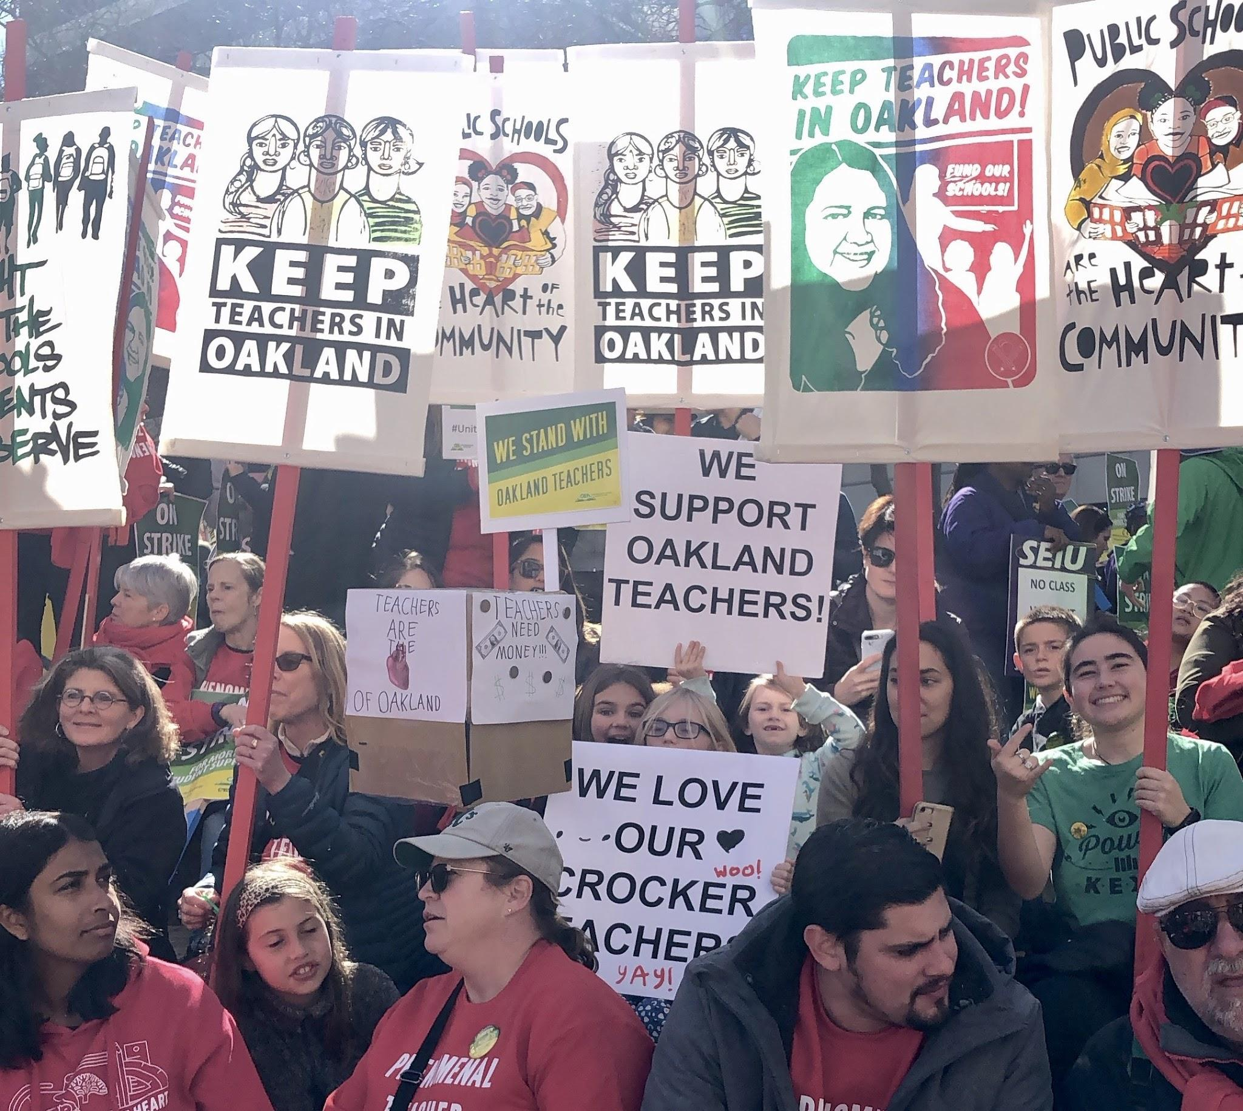
Legal Responsibilities
California State law prohibits using STs as unpaid
substitute teachers.
Please be aware of and respect the legal and procedural limitations of your ST's classroom responsibilities.
STs must not cross picket lines or enter schools during labor disputes, industrial work actions, or strikes.
For more information, please review the CT Handbook.

Slide 16
Cooperating Teacher Strategies (August~September)
Have the ST observe diverse groups of students and teachers (particularly, support classes, ELD, students with special needs, Advanced Placement and International Baccalaureate classes, classes at every grade level), and discuss the merits of different teaching strategies in weekly meetings.
Carefully review attendance and other classroom policies and procedures, such as grading, record keeping, parental communication, and other aspects of daily teaching responsibilities with ST.

Slide 17
Cooperating Teacher Strategies (September~November)
By the end of September, please allow the ST to lead warm-ups or short activities (e.g., a review of content, a pop quiz, a Kahoot game, a stretching session). This exercise allows them to get to know their middle and high schoolers who will become their students in the Spring, and, serves as preparation before the 3-Day Solo.
The 3-Day Solo, a culminating assessment (p.22-23 CT Handbook), should be delivered before Thanksgiving. You and the university supervisor need to evaluate the ST’s delivery of the lessons and determine if they are ready to co-teach in spring and assume different roles assigned by the CT.

Slide 18
Cooperating Teacher Strategies (January ~ May)
Cooperatively plan daily activities.
Instruct the ST to prepare the following week’s lesson plans well in advance. (It is best to agree upon a fixed schedule and specific day to minimize misunderstandings and maximize collaboration and input.) (SED 660, see p. 22-23 CT Handbook)
Observe the ST closely before ascertaining their skill level and giving them latitude to plan and execute instructional activities.
Share your instructional materials when necessary and allow the ST to develop new materials.
Give the ST guidance in obtaining appropriate and creative educational materials.
Discuss and review building safe and effective classroom environment during weekly conferences.

Slide 19
For more information, please review the Cooperating Teaching Handbook. For questions, contact Ms. Guilaine Salomon (Field Placement Coordinator) or the University Supervisor assigned to work with you and your ST.

Slide 20
Chapter 3
Universal Design for Learning (UDL)
Multi-Tiered System of Support (MTSS)
“Inclusive education allows students of all backgrounds to learn and grow side by side, to the benefit of all.”
Unicef
Professional Development Resources - Inclusive Education

Slide 21
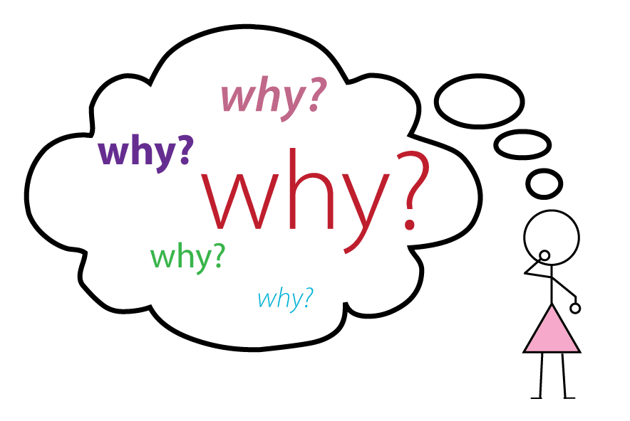
Universal Design for Learning (UDL)
2 Why
A 10:30 TED Talk by a deaf and American Sign Language speaker
1 What and How
A 4:36 video

Slide 22
Traditional Instruction vs. UDL Instruction
Teachers typically deliver content one way.
Students are passive learners who acquire information through memorizing, practicing, and taking tests.
The learning environment encourages students to sit quietly and work on an identical task.
Students’ skills and knowledge of content are assessed using one method.
Teachers deliver content in multiple ways.
Students are active learners who engage and analyze the content to gain understanding.
The learning environment encourages students to explore the content based on personal interests, preferences, or abilities.
Students are allowed to demonstrate their skills and knowledge of content using one of several methods.
https://iris.peabody.vanderbilt.edu/module/udl/cresource/q1/p01/#content

Slide 23
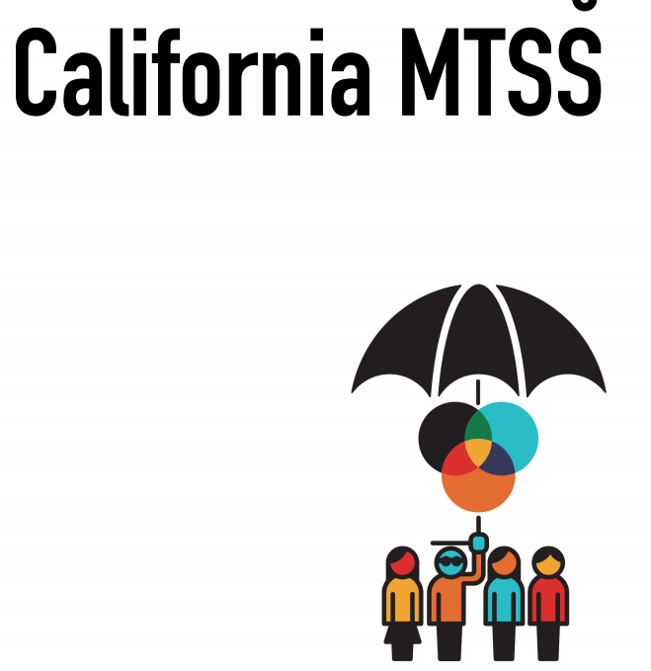
MTSS - Multi-Tiered System Of Support (CA Dept Of Education) California’s vast and complex prekindergarten through grade twelve (Prek–12) educational system requires a multifaceted approach that is scalable and sustainable. The California Department of Education’s (CDE) vision of one “coherent system of education” offers an opportunity to build the foundation for educational excellence. Through the use of Implementation Science, Universal Design for Learning (UDL), and the Whole Child approach, among other evidence-based interventions, MTSS affords a full range of academic, behavioral, and social-emotional support for all students to achieve.
Definition Of MTSS - Multi-Tiered System Of Support (CA Dept Of Education). Cde.ca.gov. N.p., 2018. Web. 11 May 2018.
What is Multi-Tiered System Of Support (MTSS) ?
A 7:00 Intro by CA Teachers Association
Please review: Guide to MTSS and The MTSS Framework

Slide 24
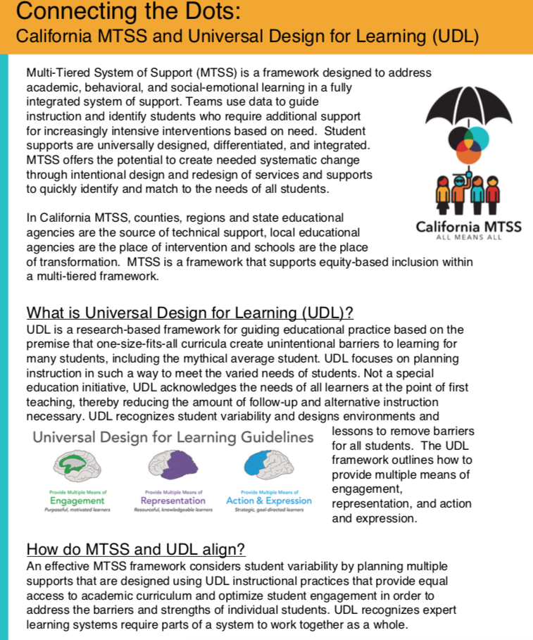
MTSS and UDL - How are they related?

Slide 25
Chapter 4
CRT talk
CRT framework
Awareness
learning partnerships
information processing
community of learners/learning environments
Professional Development Resources - Culturally Responsive Teaching (CRT)

Slide 26
Watch: 'Culturally Responsive Teaching' by Dr. Zaretta Hammond (22:49)
The author of "Culturally Responsive Teaching (CRT) and the Brain" (2014) explains how her personal experiences led her to investigate what children need to have an academic mindset. Dr. Hammond also explains how "grit" and "pep talks" aren't the solution when early learners struggle during The Learning Pit.

Slide 27
You will read four aspects of CRT - awareness, learning partnerships, information processing, and community of learners/learning environments.
Choose one aspect to focus on at a time so you can make clear goals for your growth.
Framework for Culturally Responsive Teachers

Slide 28
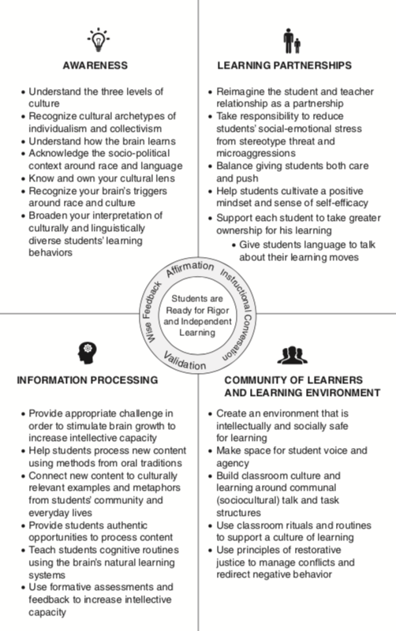
Overview
Hammond, Z. L. (2014). Culturally responsive teaching and the brain: Promoting authentic engagement and rigor among culturally and linguistically diverse students. Thousand Oaks: SAGE (p. 17)

Slide 29
Practice Area I: Awareness
Every culturally responsive teacher develops a socio-political consciousness, an understanding that we live in a racialized society that gives unearned privilege to some while others experience unearned disadvantage because of race, gender, class, or language.
They are aware of the role that schools play in both perpetuating and challenging those inequities.
They are also aware of the impact of their own cultural lens on interpreting and evaluating students’ individual or collective behavior that might lead to low expectations or undervaluing the knowledge and skills they bring to school. (Hammond, 2014, p. 18)

Slide 30
Practice Area II: Learning Partnerships
Every culturally responsive teacher builds capacity to establish an authentic connection with students that builds mutual trust and respect.
They leverage the trust bond to help students rise to higher expectations.
They give feedback in emotionally intelligent ways so students are able to take it in and act on it.
They hold students to high standards while offering them new intellectual challenges.
(Hammond, 2014, p. 19)

Slide 31
Practice Area III: Information Processing
Every culturally responsive teacher knows how to strengthen and expand students’ intellective capacity so that they can engage in deeper, more complex learning.
They mediate student learning based on what they know about how the brain learns and students’ cultural models.
They engage students in high-leverage social and instructional activities that over time build higher order thinking skills.
(Hammond, 2014, p. 19)

Slide 32
Practice Area IV: Community Building
Every culturally responsive teacher creates an environment that feels socially and intellectually safe for dependent learners to stretch themselves and take risks.
They try to create an environment that communicates care, support, and belonging in ways that students recognize.
They set up rituals and routines that reinforce self-directed learning and academic identity.
(Hammond, 2014, p. 20)

Slide 33
You are on your way to completing your 10 hours of professional development fulfillment. You need only complete these 10 hours ONCE in a lifetime to fulfill the requirement.
Once you click the link on the left, you will be prompted to submit your work email first then proceed to the reflection prompts.
Thank you for your valuable contribution to the professional training of our new teachers.
Chapter 5
Review and Reflections

